Slide 1


Effective Data Visualization

Slide 2
Motivations

Slide 3
Motivations
Visualization is important.
We will teach you how to make Effective Visualization.
We will teach you how to do Exploratory Data Analysis.

Slide 4
Contents

Slide 5
Contents:
Why Visualization Important
To understand the data
Computationally Cheap
Descriptive Statistics cannot tell the story
Effective Data Visualization
Data Visualization Integrity
Maximize Data-to-Ink ratio
Avoid Chart Junk
Exploratory Data Analysis
Tools
Perceptual Effectiveness

Slide 6
Effective Data Visualization
Source of slides: Most of the slides are from Data Sciences class 109, Harvard, Joe Biltzstein

Slide 7
Why Visualization Important

Slide 8
Why Visualization Important:
To Understand the Data

Slide 9
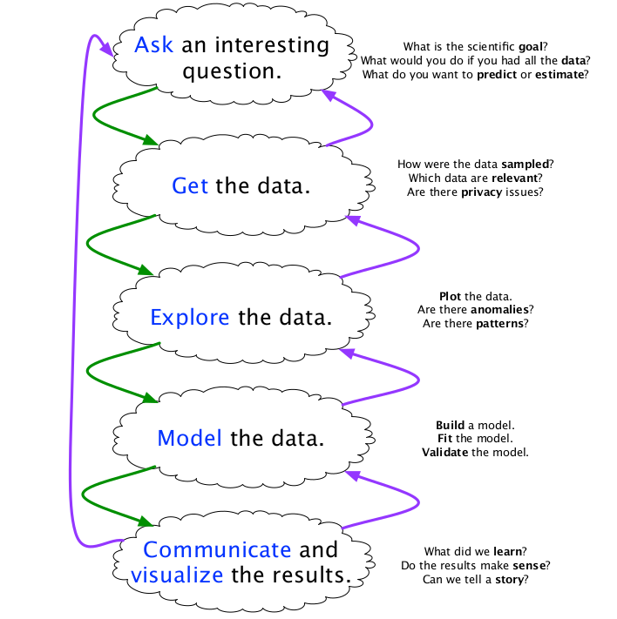
Why:
To Understand Data
Modeling Philosophy: You have to know the data, how the real world system generate the data, then you can build a “good” model.
Remember:
Data Generating Process

Slide 10
Why:
To Understand Data
General Goal: To convey information through graphical representations of data “The greatest value of a picture is when it forces us to notice what we never expected to see” - John Tukey

Slide 11
Why:
To Understand Data
Specific Goal:
Communicate (Explanatory)
Present data and ideas
Explain and inform
Provide evidence and support
Influence and persuade
Analyze (Exploratory)
Explore the data
Asses a situation
Determine how to proceed
Decide what to do

Slide 12
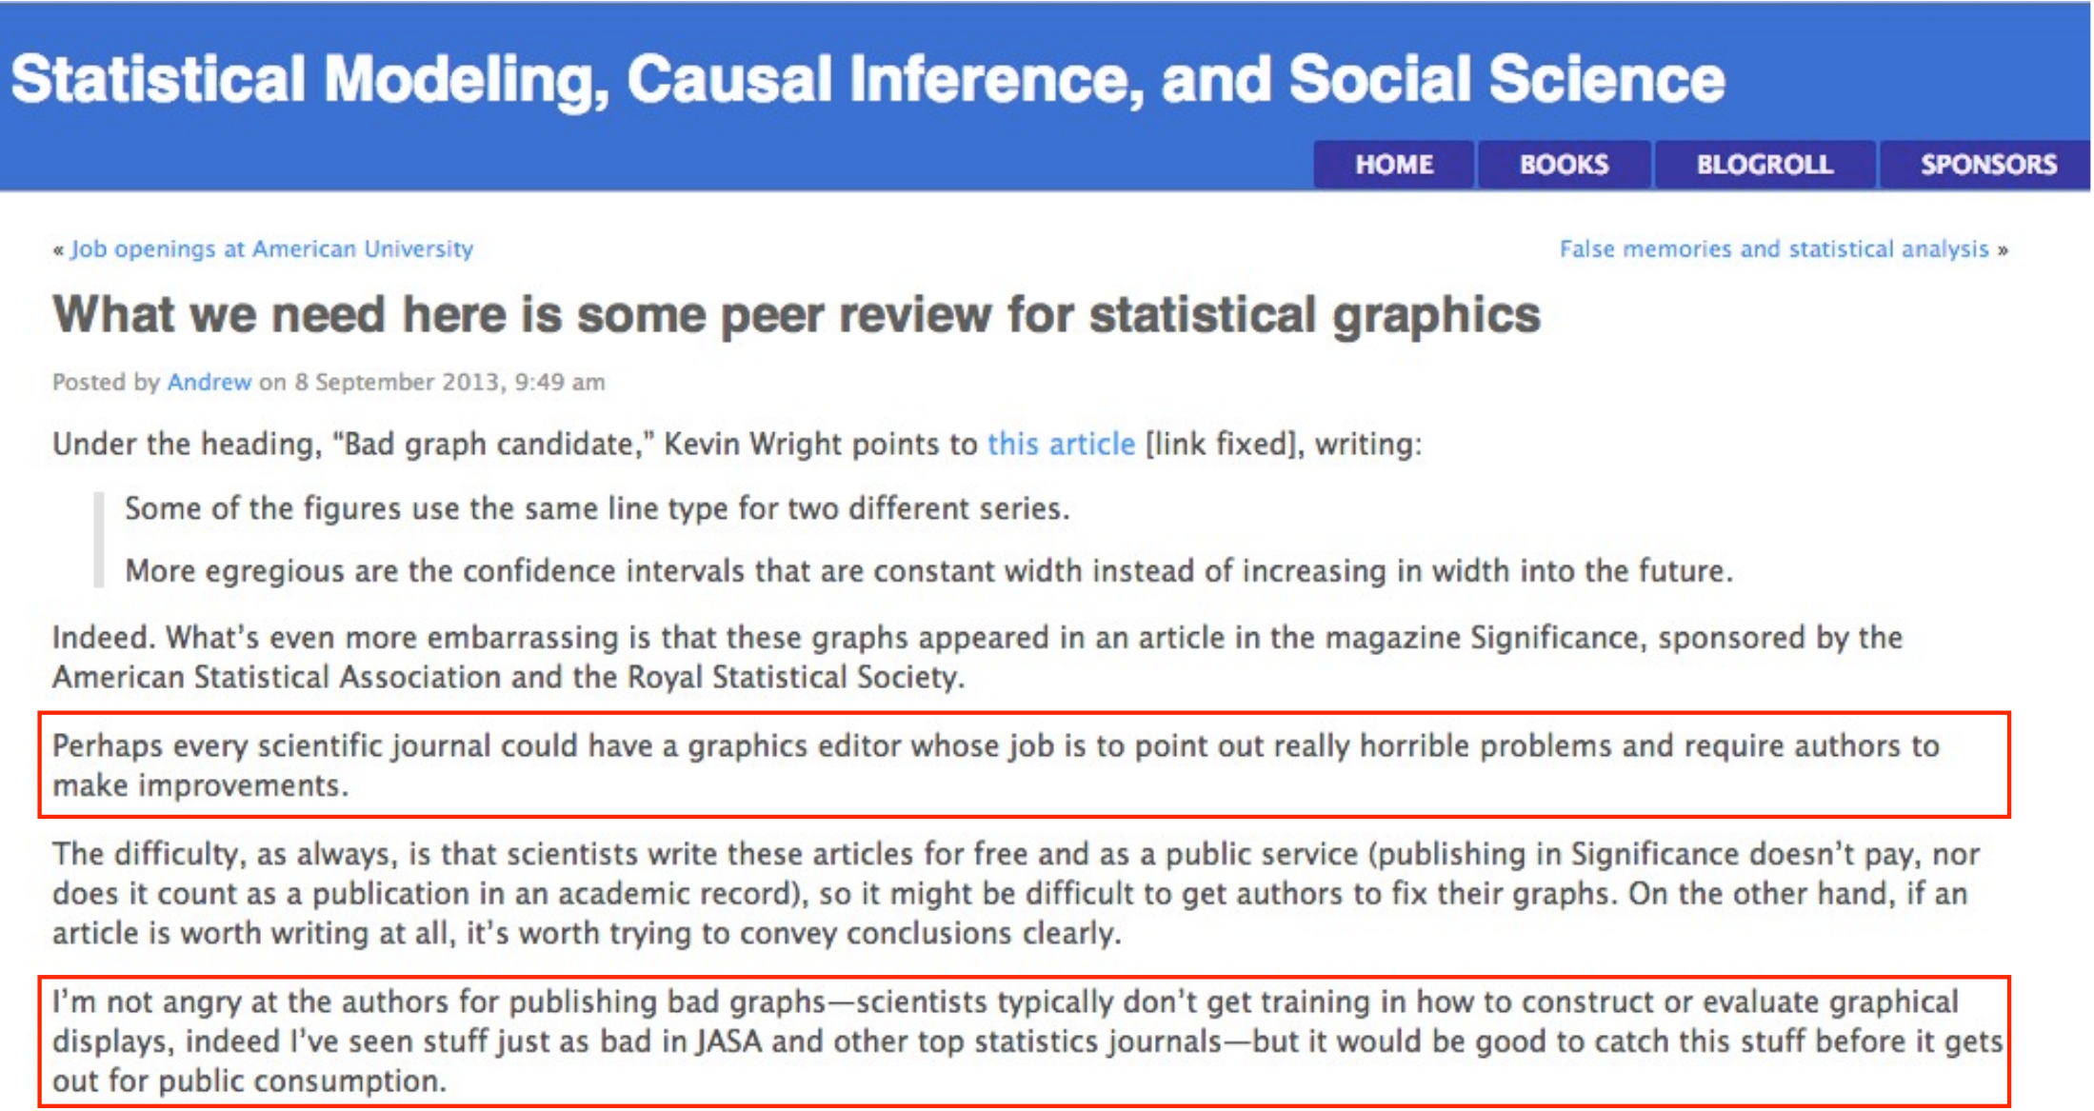
Why:
To Understand Data

Slide 13
Why Visualization Important:
Computationally Cheap

Slide 14
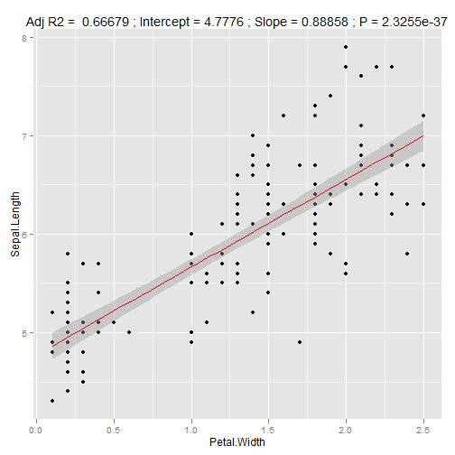
Why:
Computationally Cheap
n = Number of observations, p= Number of variables
Imagine you have (1.000.000.000, 2)
Visualization is fast

Slide 15
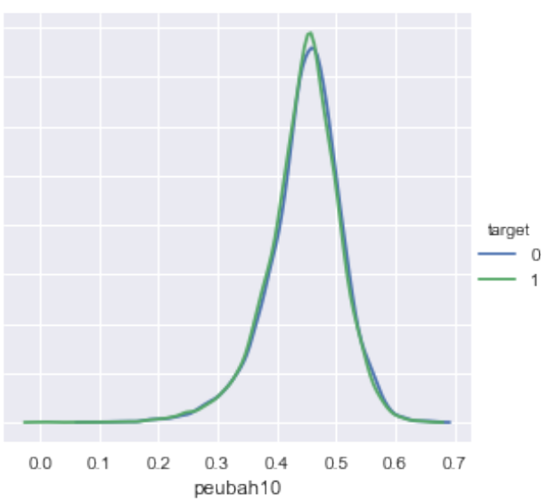
Why:
Computationally Cheap
Distribution 0 and 1, Numer.ai competition
Almost no signal in the data

Slide 16
Why Visualization Important:
Descriptive Stats might Wrong

Slide 17
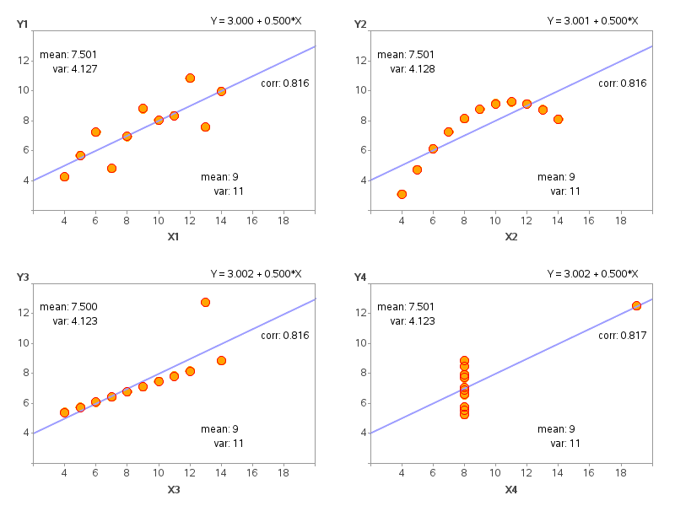
Why:
Descriptive Stats might Wrong
Anscombe’s quartet

Slide 18
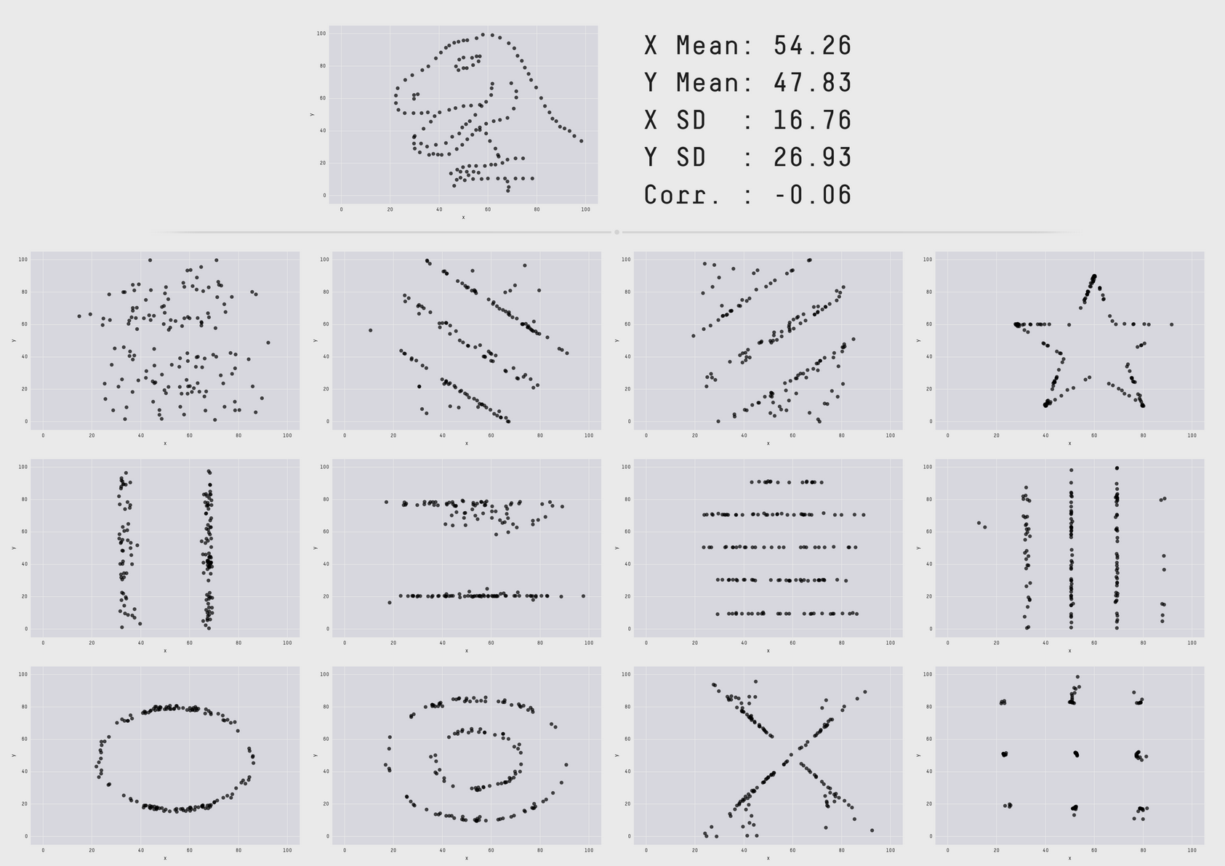
Why:
Descriptive Stats might Wrong

Slide 19

Why:
Descriptive Stats might Wrong
Source: https://www.autodeskresearch.com/publications/samestats

Slide 20
Why
Take home messages:
You have to do visualization because:
You have to understand your data
Visualization is computationally cheap
Descriptive Stats might wrong

Slide 21
Questions?

Slide 22
Effective Visualizations

Slide 23
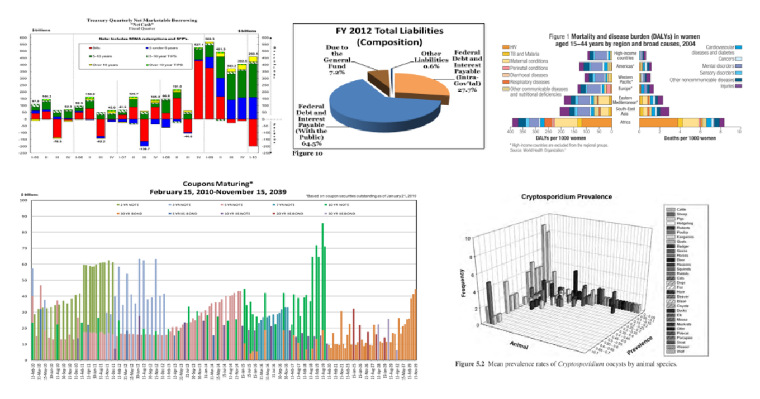
Not Effective
See: viz.wtf
sesee

Slide 24
Effective Visualizations: Tufte
Clear, detailed, and thorough labeling and appropriate scales. Size of the graphic effect should be directly proportional to the numerical quantities (“lie factor”)
Maximize data-ink ratio
Avoid chart junk

Slide 25
Effective Visualization:
Graphical Integrity

Slide 26
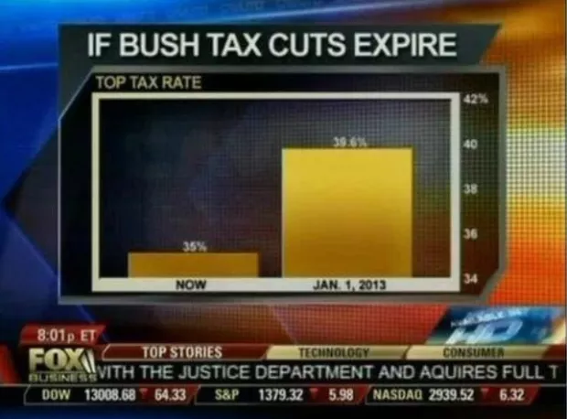
Don’t: Scale Distortion

Slide 27
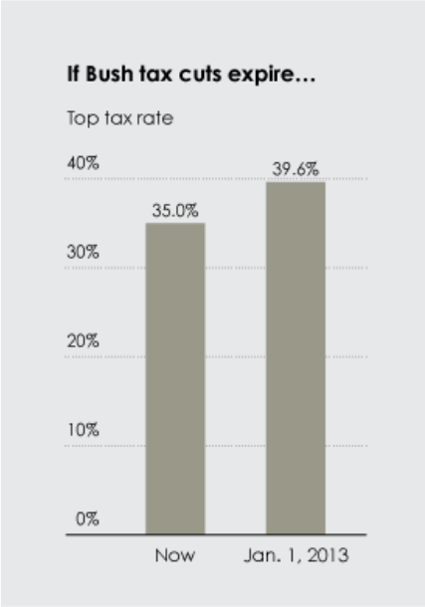
Scale Distortion

Slide 28
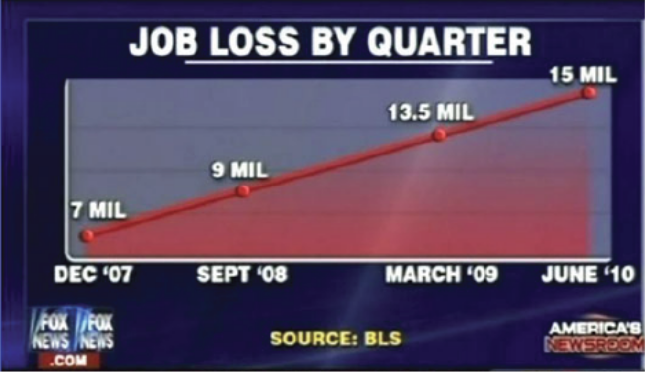
Don’t: Scale Distortion

Slide 29
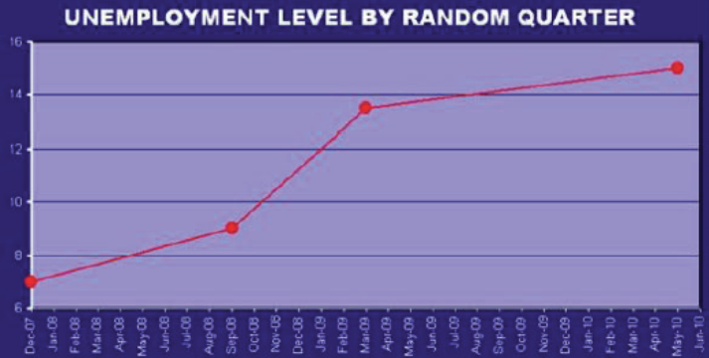
Don’t: Scale Distortion

Slide 30
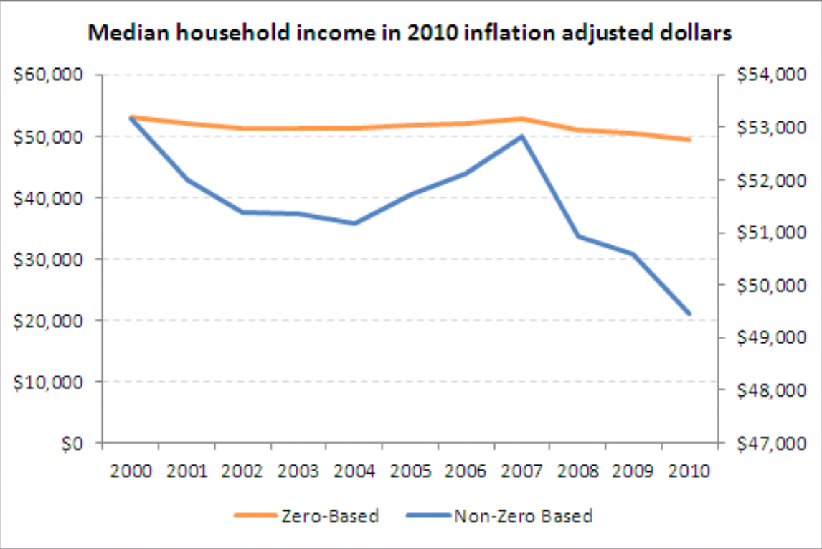
Don’t: Scale Distortion

Slide 31
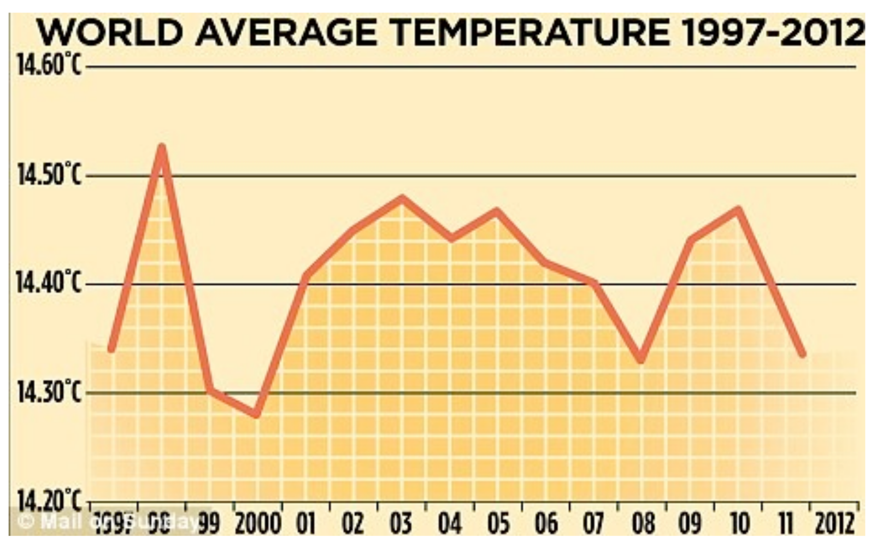
Don’t: Scale Distortion

Slide 32
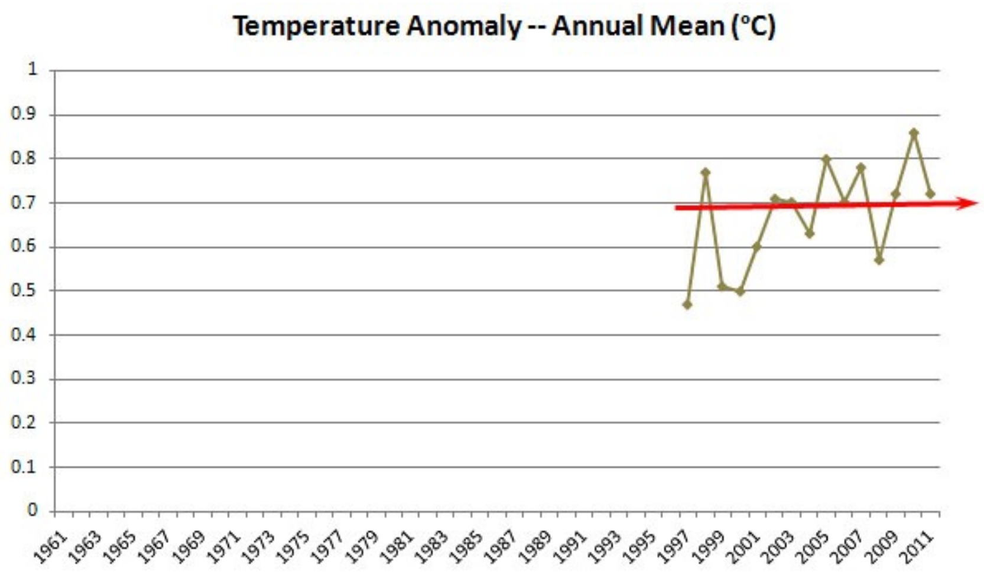
Don’t: Scale Distortion

Slide 33
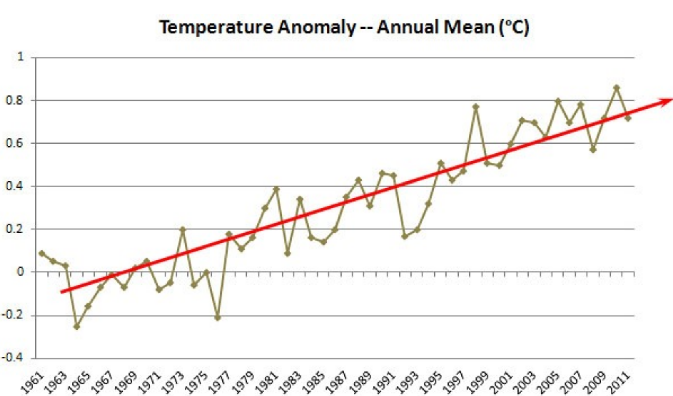
Don’t: Scale Distortion

Slide 34
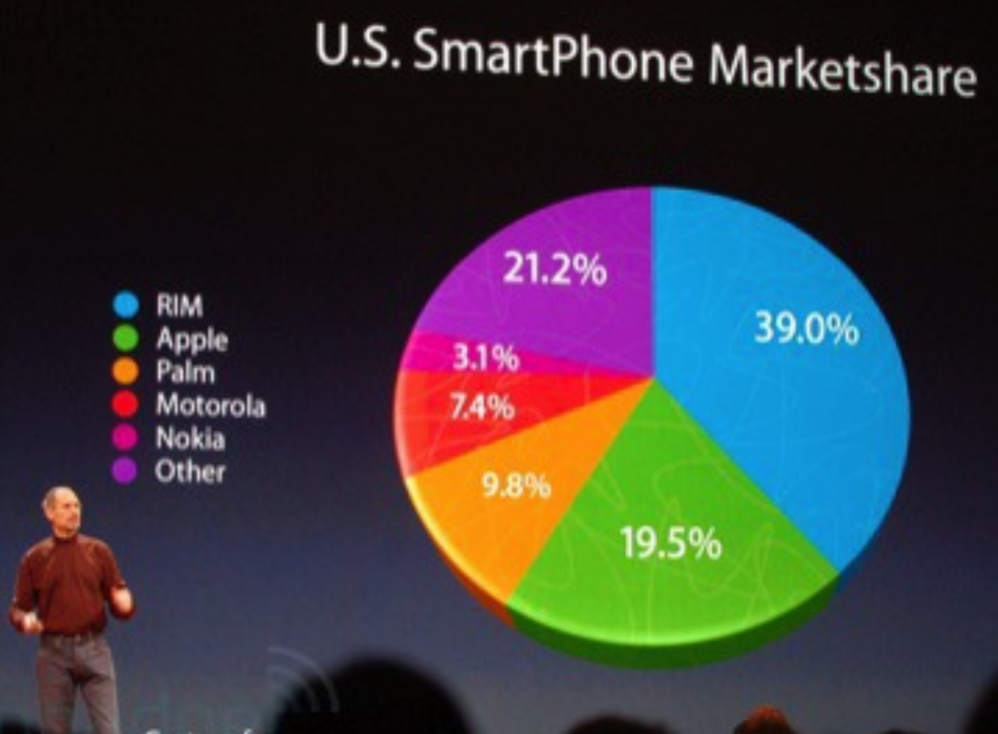
Don’t: Scale Distortion

Slide 35
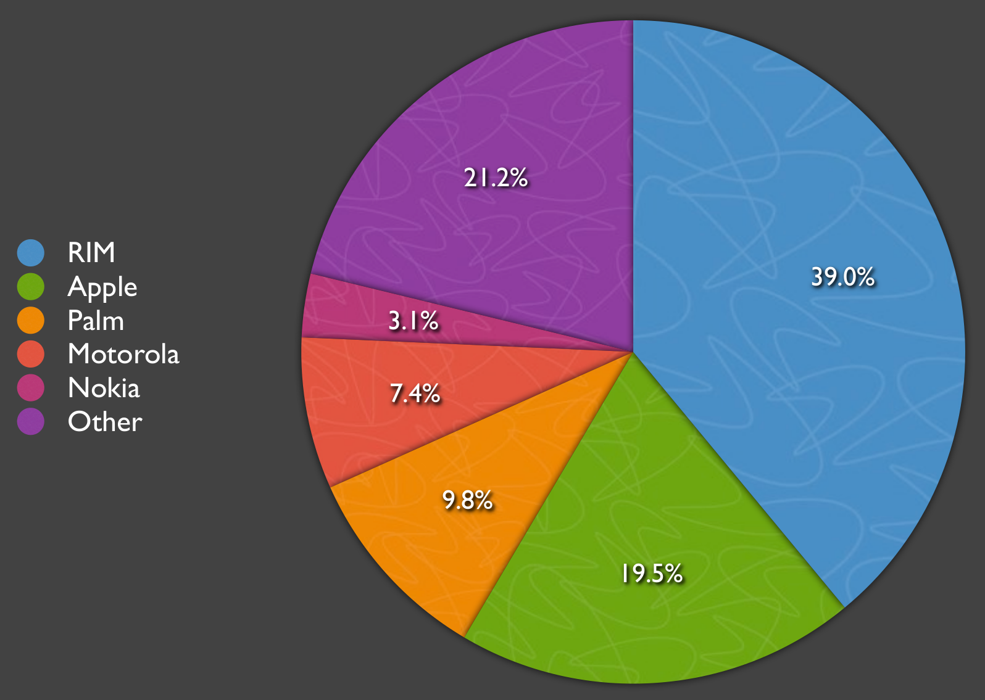
Don’t: Scale Distortion

Slide 36
Scale Distortions
Take home messages:
Start your graph from 0.
Don’t tilt the graph..
Be honest

Slide 37
Questions?

Slide 38
Effective Visualization:
Maximize Data-to-Ink Ratio

Slide 39

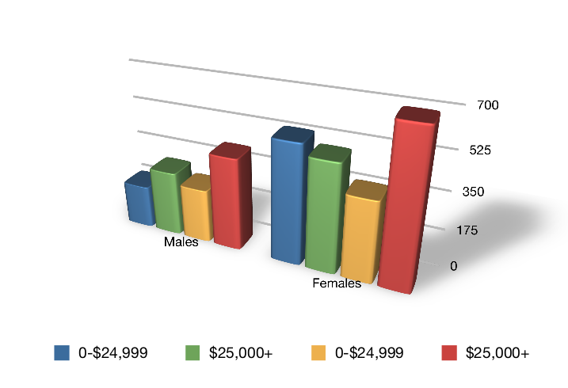
Maximize Data-Ink Ratio

Slide 40
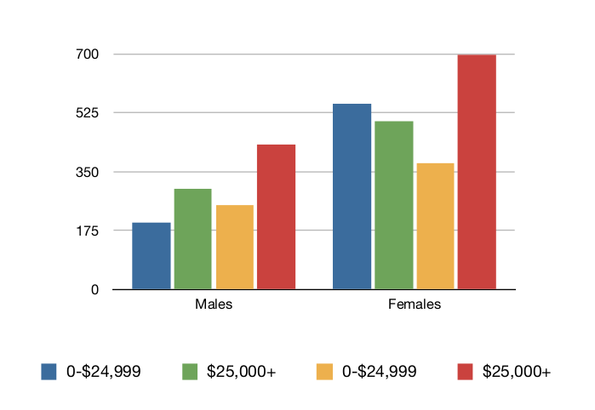
Maximize Data-Ink Ratio
Maximize Data-Ink Ratio

Slide 41
Effective Visualization:
Avoid Chart Junk

Slide 42
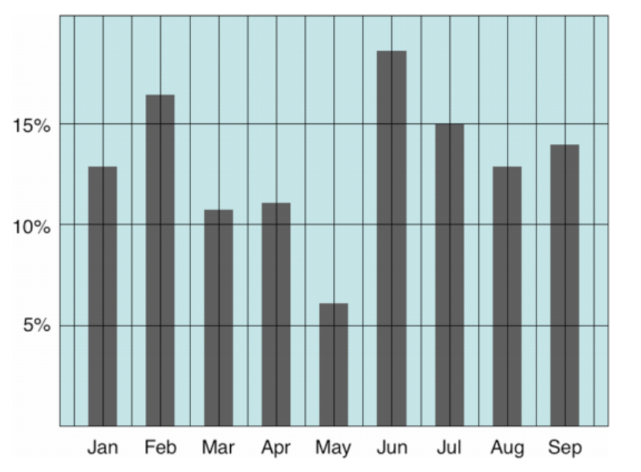
Avoid Chart Junk
Extraneous visual elements that distract from the message

Slide 43
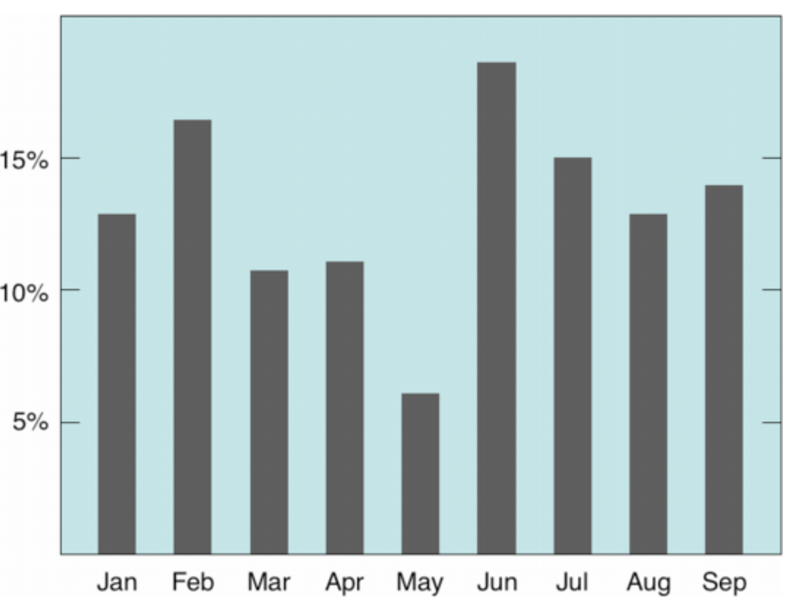
Avoid Chart Junk

Slide 44
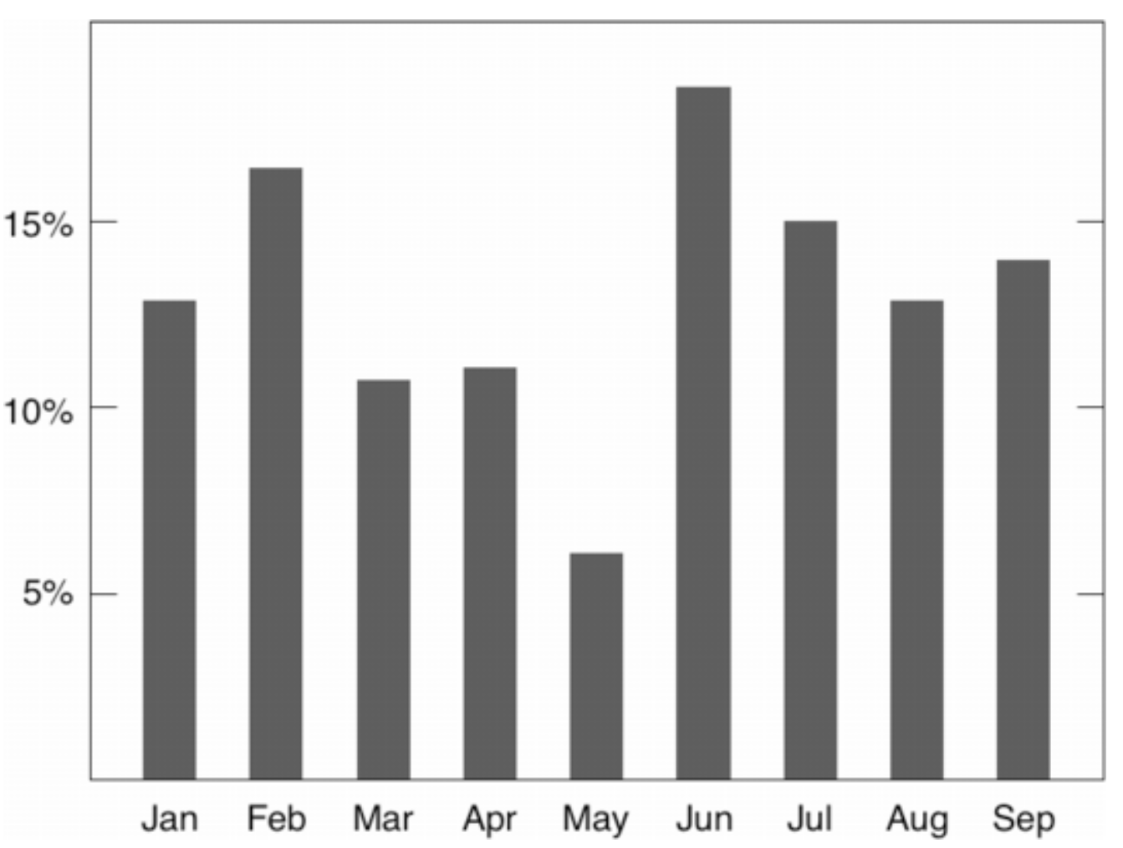
Avoid Chart Junk

Slide 45
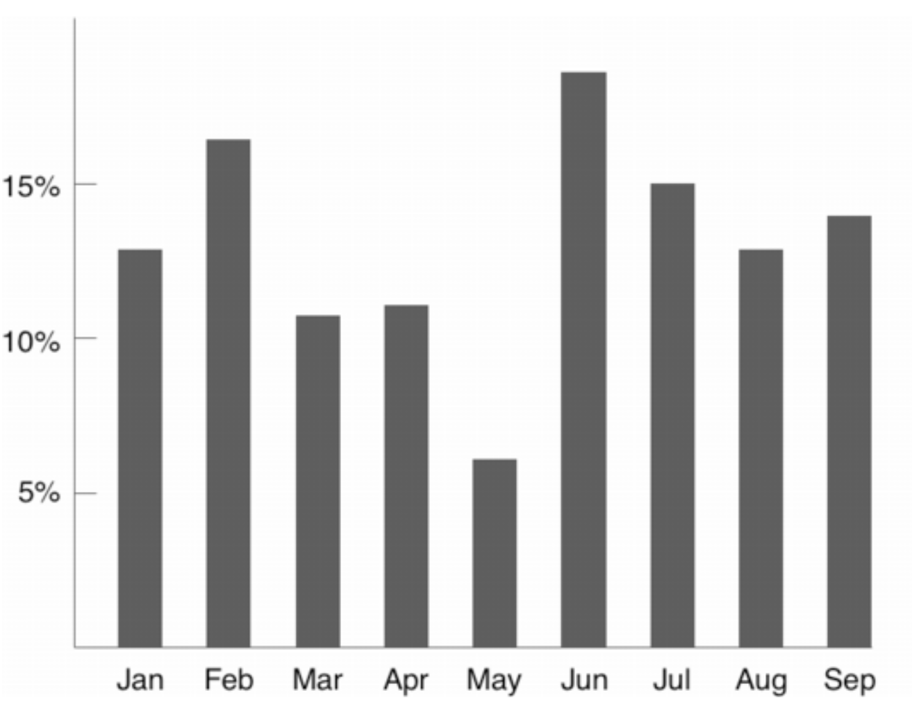
Avoid Chart Junk

Slide 46
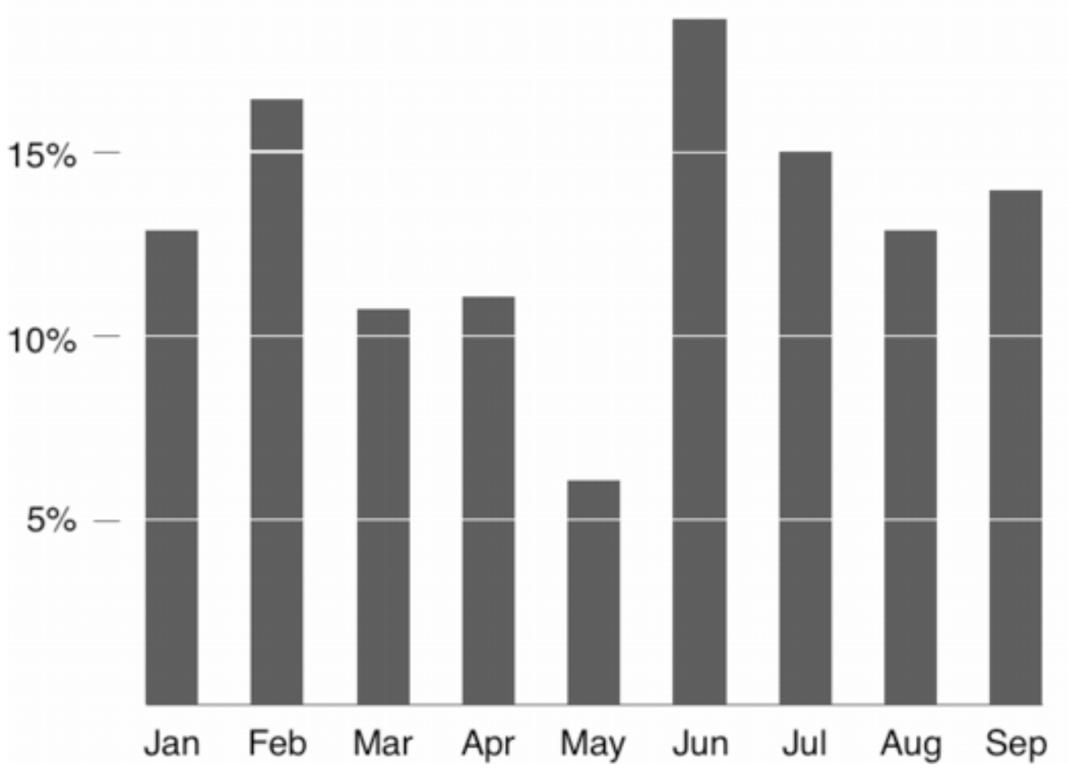
Avoid Chart Junk

Slide 47
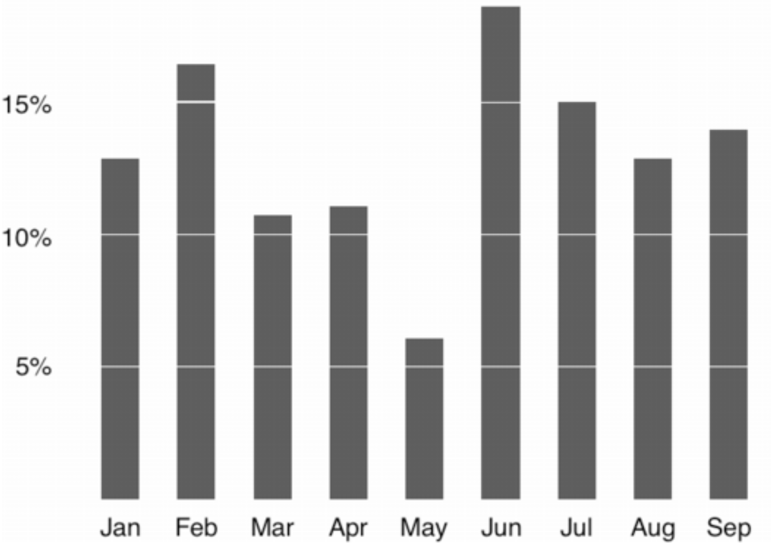
Avoid Chart Junk

Slide 48
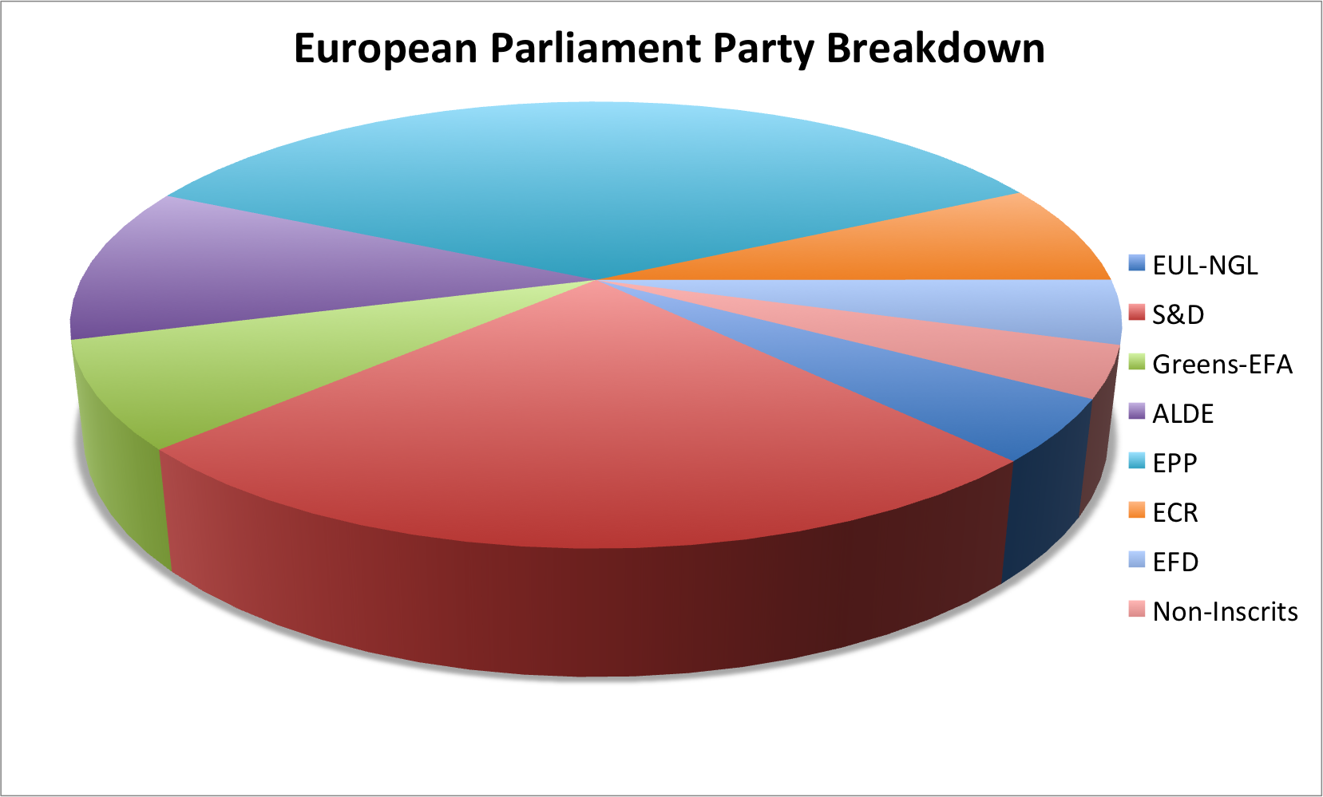
Don’t: 3D Pie Chart are Bad

Slide 49
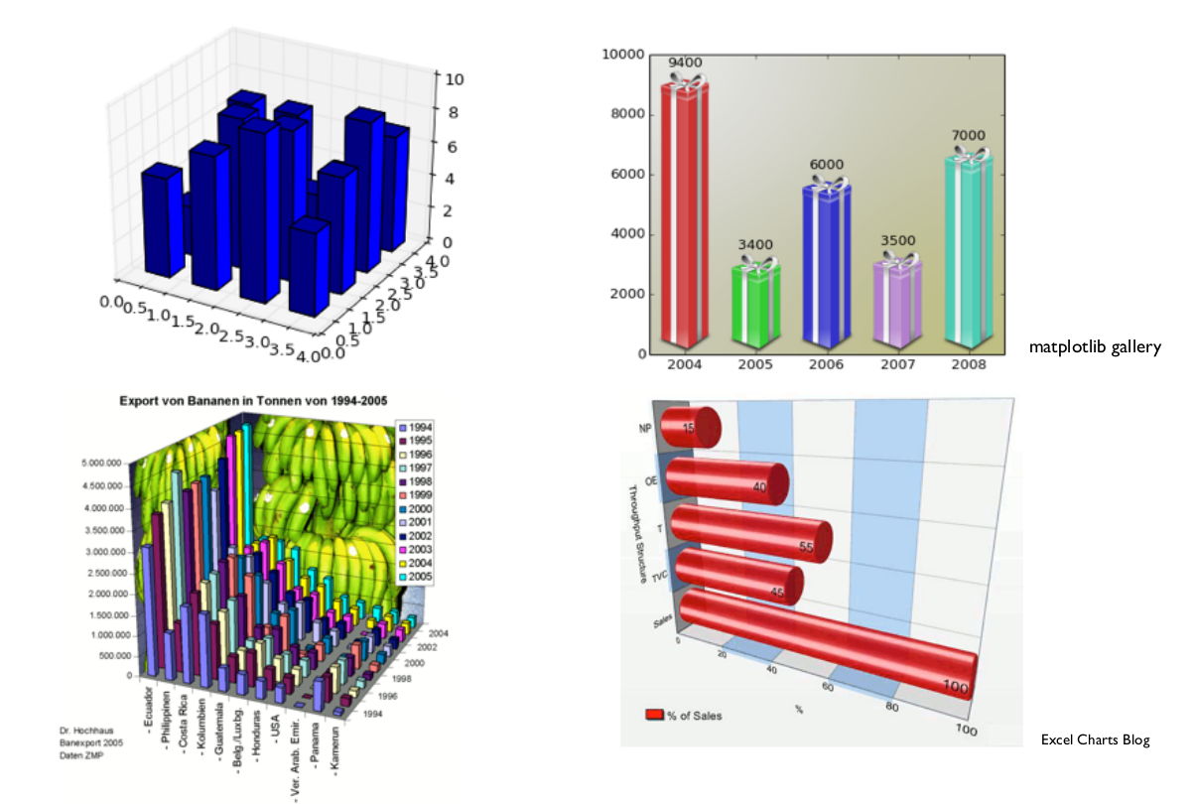
Don’t

Slide 50
Questions?

Slide 51
Exploratory Data Analysis

Slide 52
Exploratory Data Analysis:
Tools

Slide 53
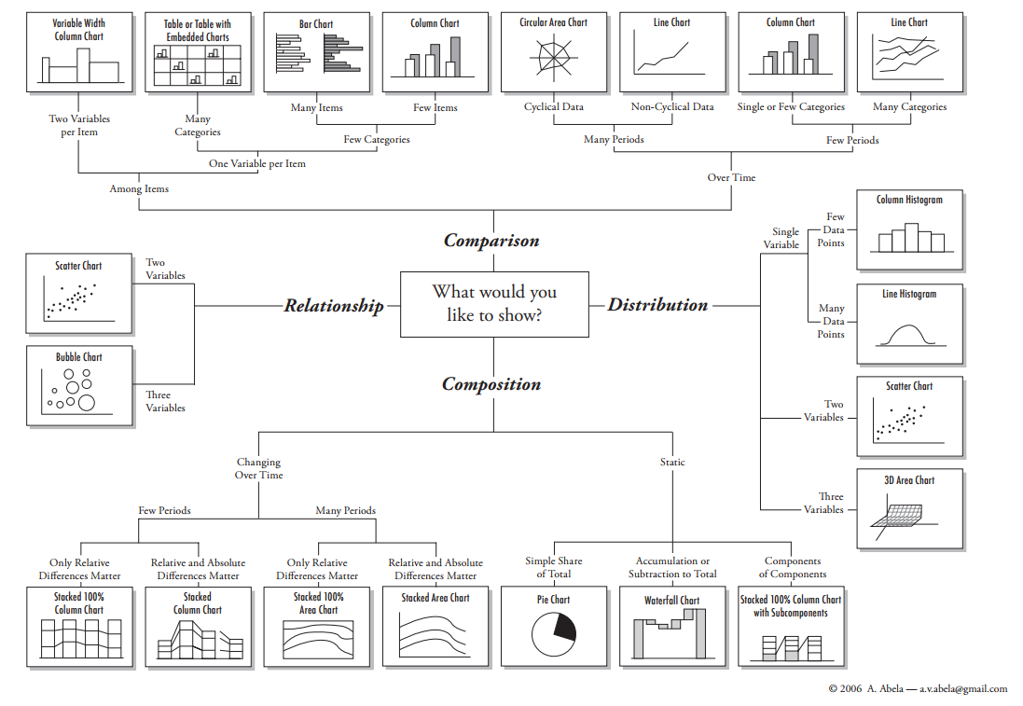
Chart Suggestion - A Thought Starter

Slide 54
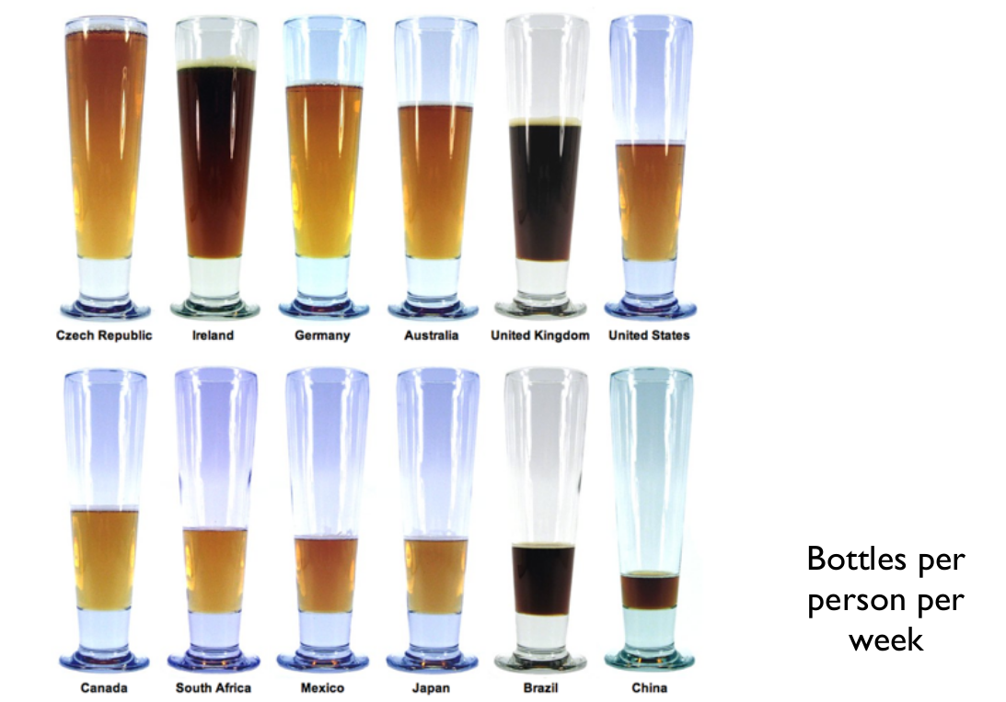
Comparison - Bar Chart

Slide 55
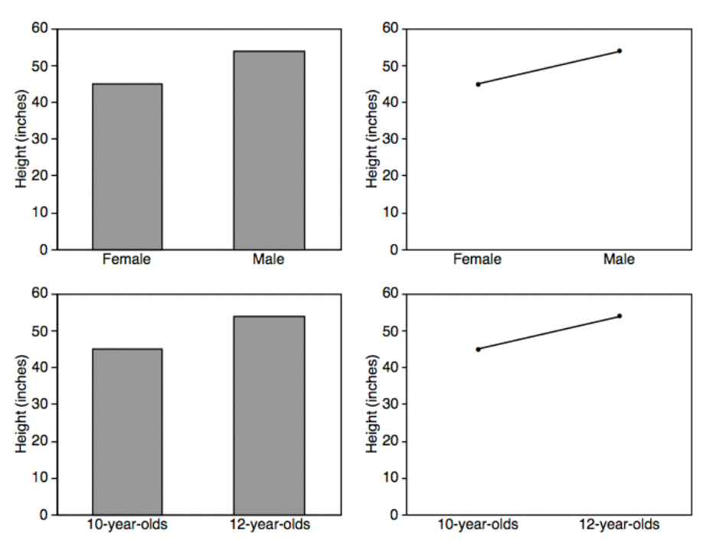
Bar vs Line

Slide 56
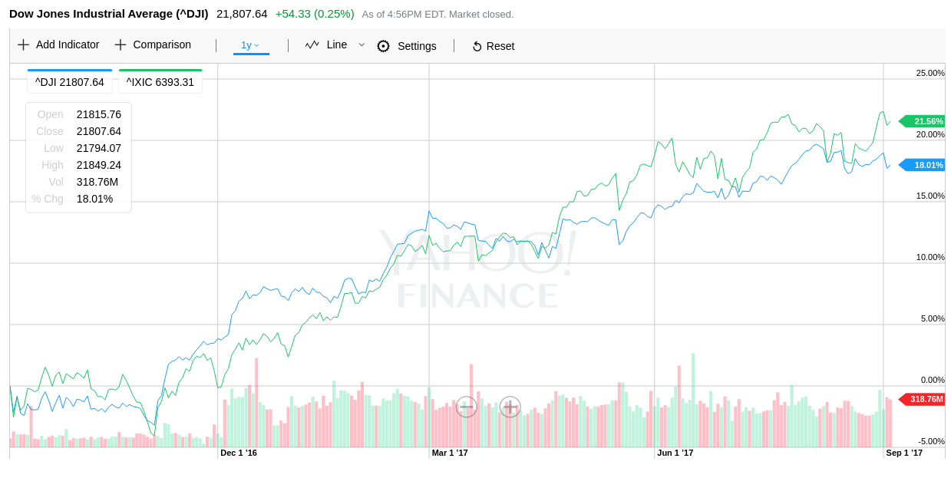
Trends

Slide 57
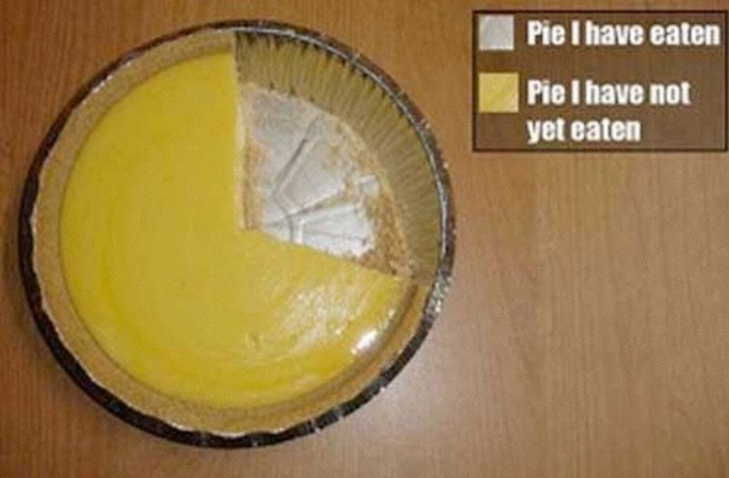
Proportions - Pie Charts

Slide 58
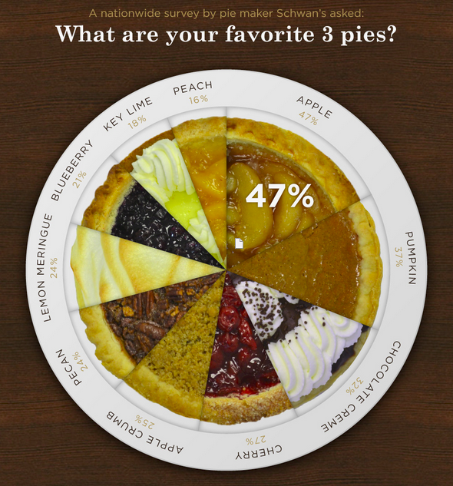
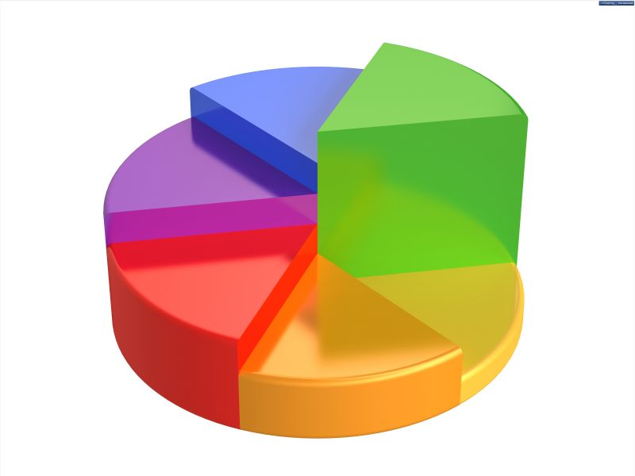
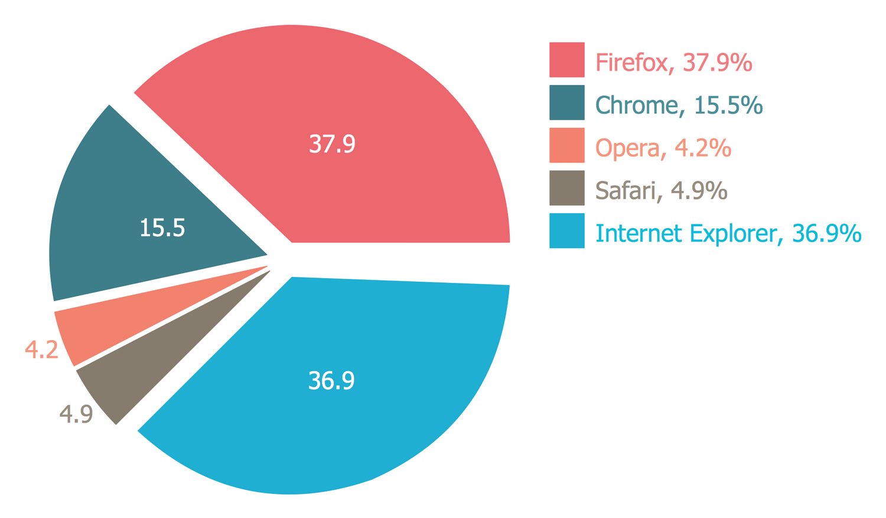
Proportions - Pie Charts

Slide 59
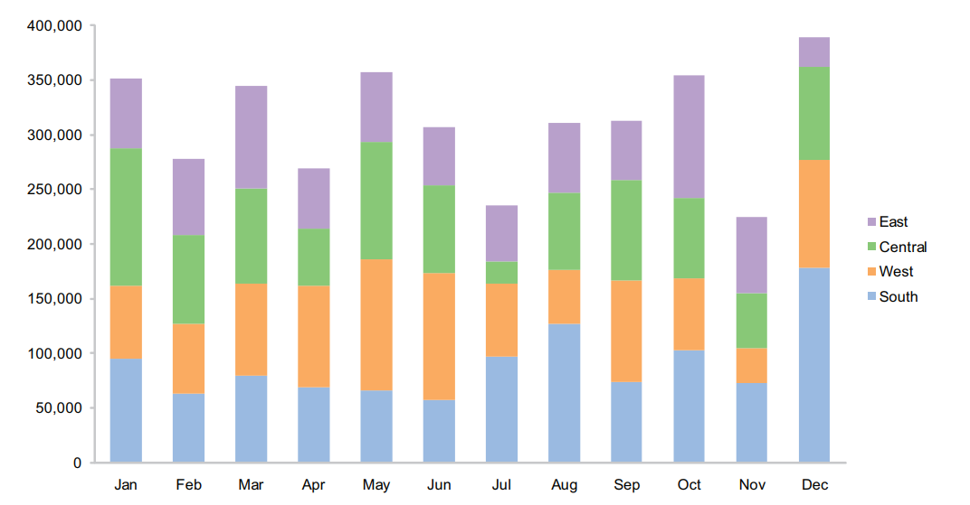
Proportions - Stacked Bar Chart

Slide 60
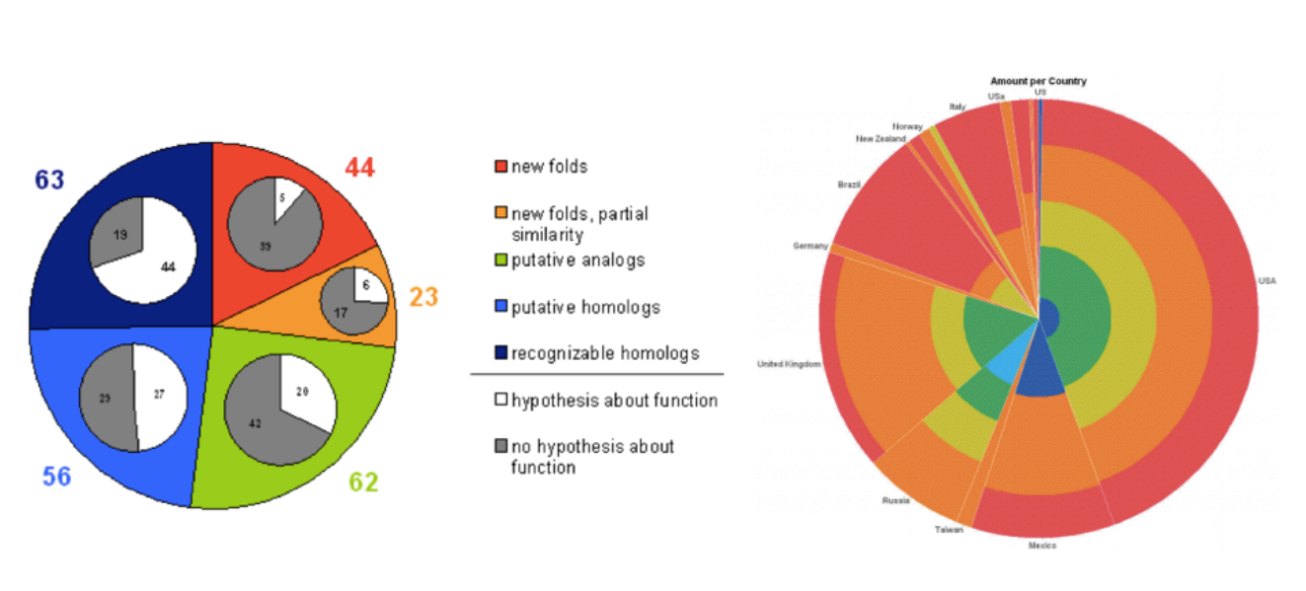
Don’t

Slide 61
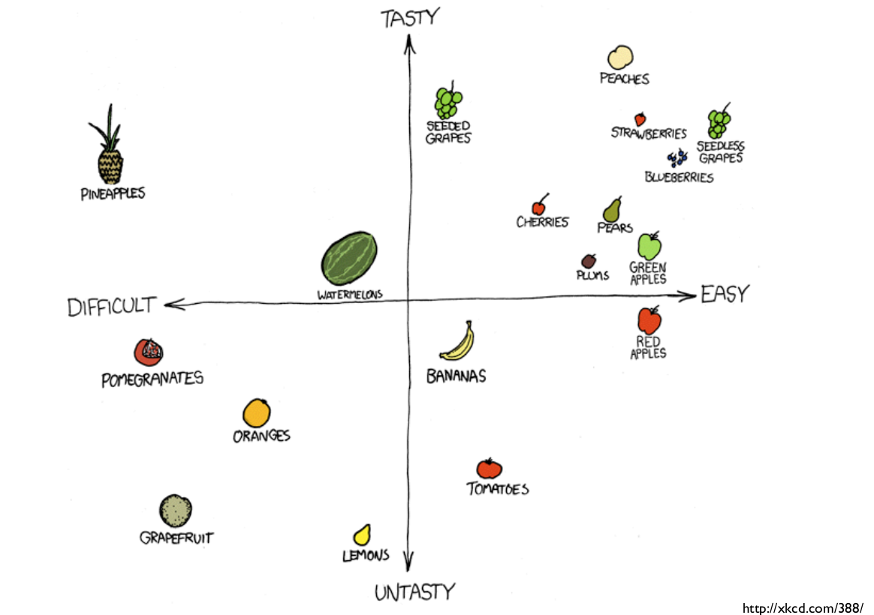
Correlation - Scatter Plot

Slide 62
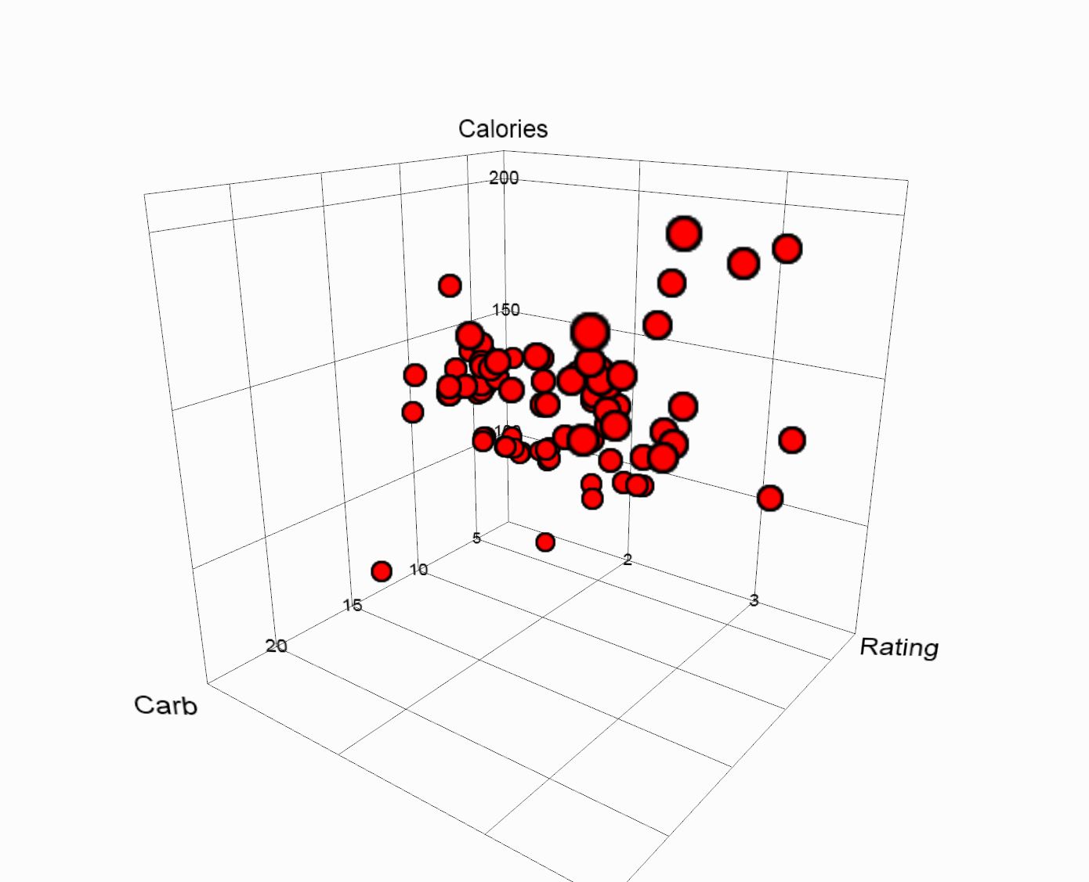
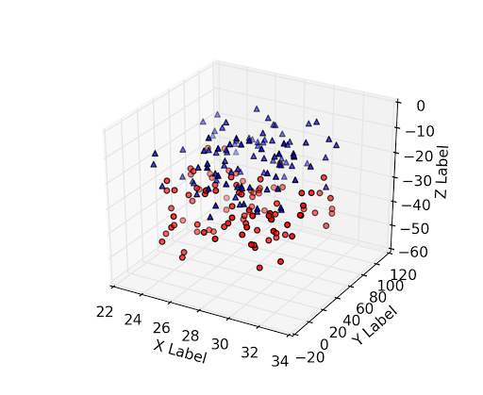
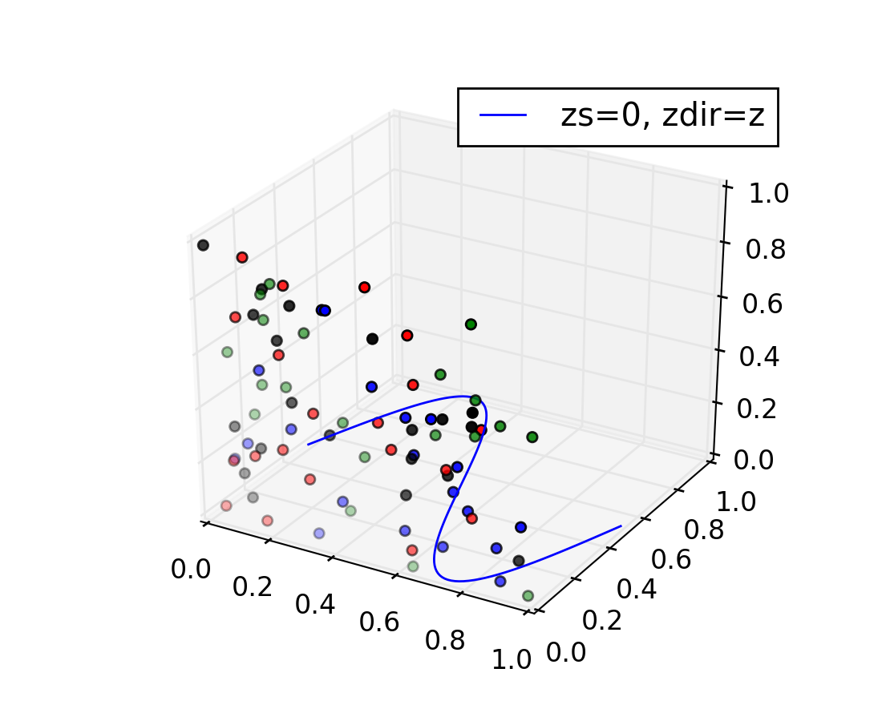
Don’t

Slide 63
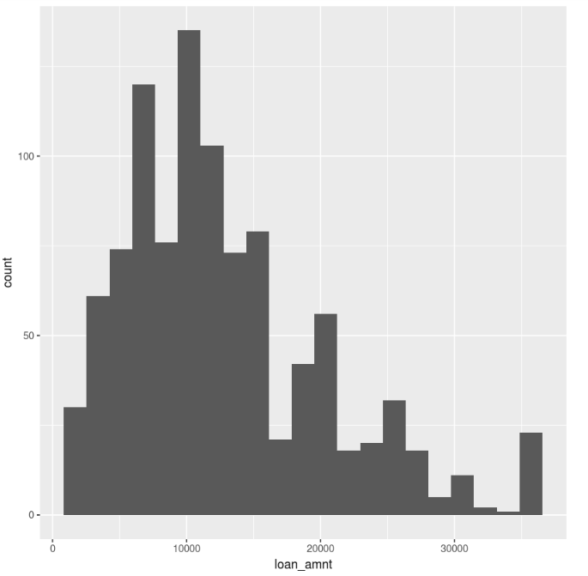
Distributions - Histogram

Slide 64
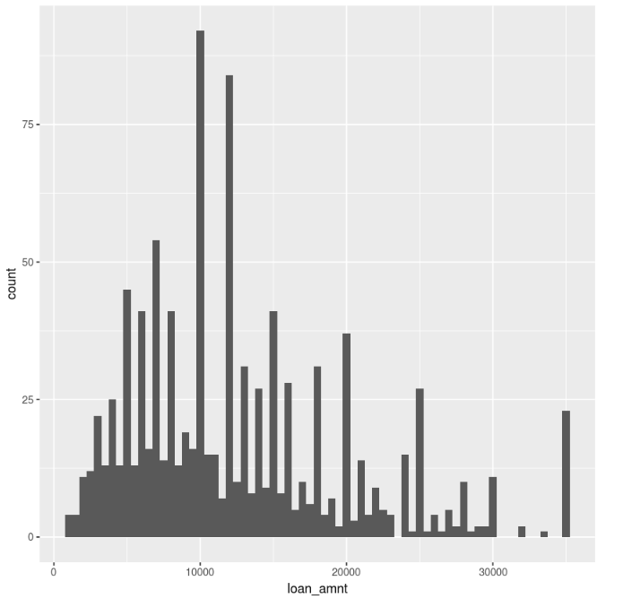
Distributions - Histogram - Binwidth

Slide 65
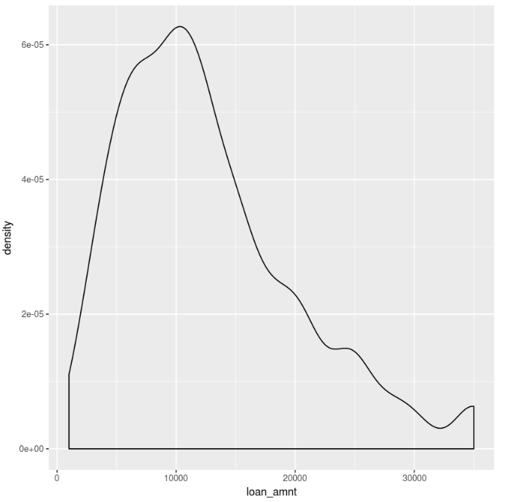
Distributions - Density

Slide 66
Exploratory Data Analysis:
Perceptual Effectiveness

Slide 67
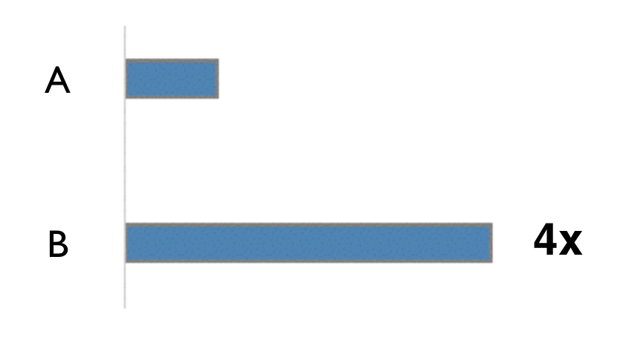
Hom much longer?

Slide 68
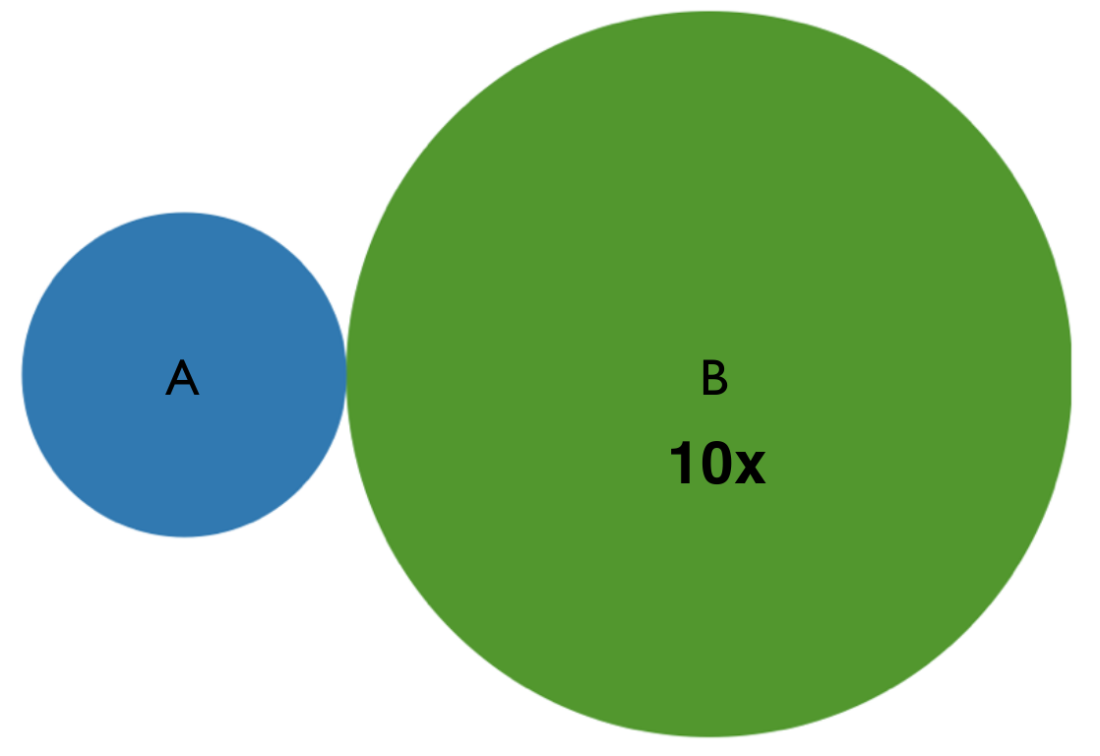
Hom much larger area?

Slide 69
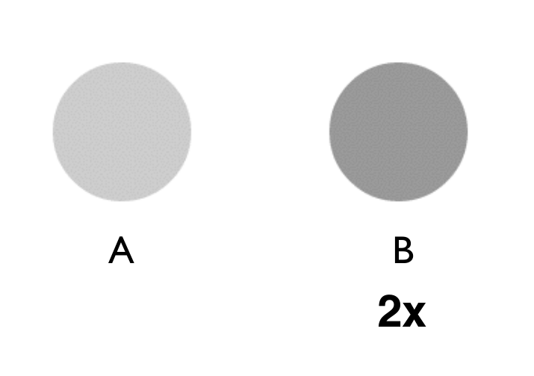
Hom much darker?

Slide 70
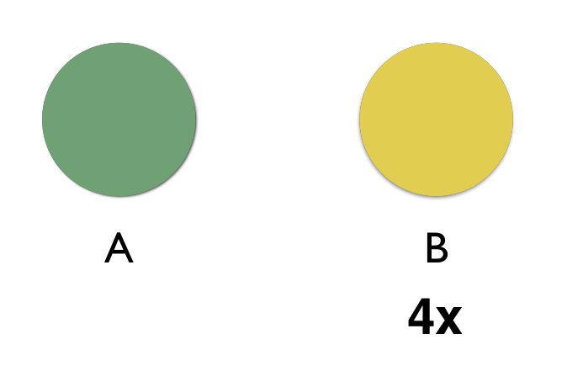
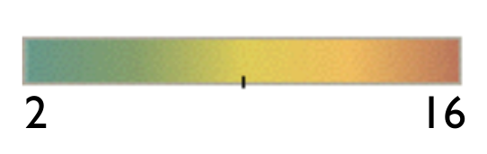
Hom much different?

Slide 71
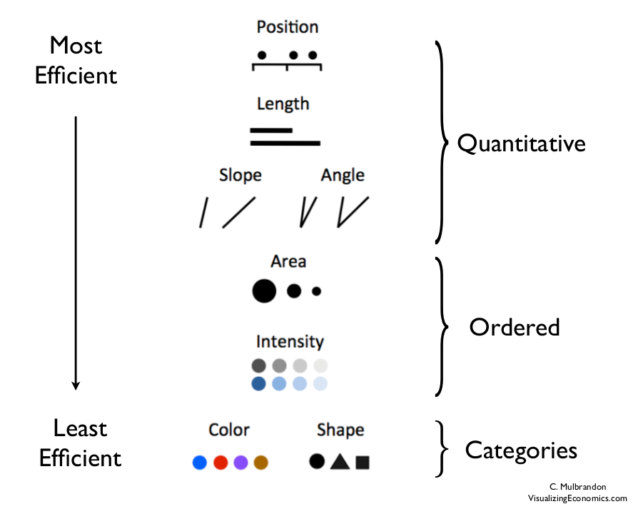

Slide 72

Most Effective

Slide 73

Less Effective

Slide 74

Bar vs Pie Chart

Slide 75

Least Effective

Slide 76
Use Color Strategically

Slide 77

Use Color to Discriminate

Slide 78

Colors for Categories
Do not use more than 5-8 colors at once

Slide 79

Colors for Quantitative Data

Slide 80

Rainbow Colormap

Slide 81

Rainbow Colormap

Slide 82

Avoid Rainbow Color

Slide 83

Color Blindness

Slide 84

Color Blindness

Slide 85

Color Brewer

Slide 86
Questions?

Slide 87
Thank you
Adityo Sanjaya
Haqi Muflih

